Slide 1
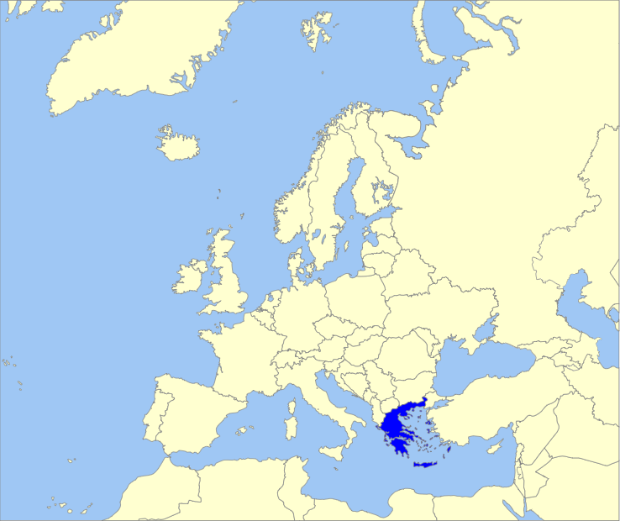
Greece
Hellenic Neonatal Society
Name of country in national language : HELLAS
No of inhabitants: 10.816.000
No of annual births: 92.898
Home page: www.neognologiki.gr
Contact address: info@neognologiki.gr
Established in 2004
Joined UENPS in 2006
Current president: Ass. Prof. Georgios Mitsiakos
Members
300 neonatologists and physicians working with newborns.
Previous activities
Seven Biannual National Congress.
Twelwe national mettings.
One IPOKRaTES seminar.
Four Hellenic Turkich Congress (with collaboration Turkish Neonatal Society).
The main current goals and challenges
Improvement perinatal outcomes – birth and neonatal transfer.
Creating national guidelines in neonatology.
Expectations from UENPS in 2018
Improve collaboration with national societes.
Improve of perinatal outcomes.
Education: Development European curriculum.
Creating European Perinatal Networks.

